Slide 1
Control System Studio
Kay Kasemir
ORNL/SNS
kasemirk@ornl.gov
Jan. 2019

Slide 2
Control System (CS) Studio
User Interface tools
Display editor & runtime
Strip Chart
Channel Access utilities
Also
Archive system
Alarm Handler
Site-Specific support for logbook, PV names, ..
.. integrated, site-specific user-interface tool for Windows, Linux, OS X

Slide 3
What does CS-Studio look like?

Slide 4
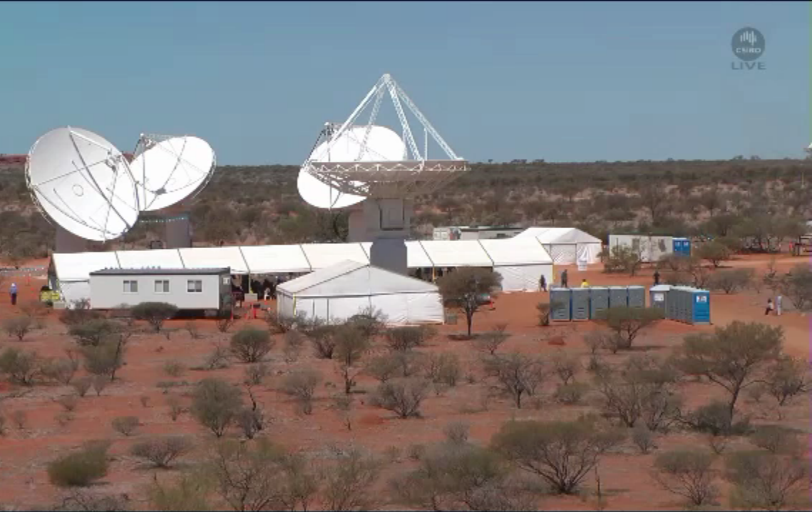
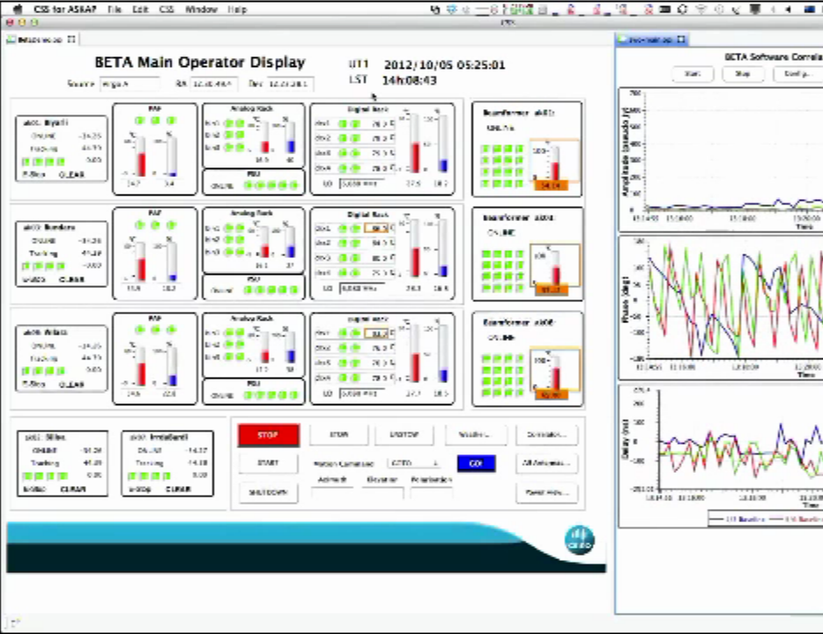
Australian Square-Kilometer Array Pathfinder (ASKAP)
Oct. 2012, Juan Guzman, http://www.aps.anl.gov/epics/tech-talk/2012/msg02113.php

Slide 5
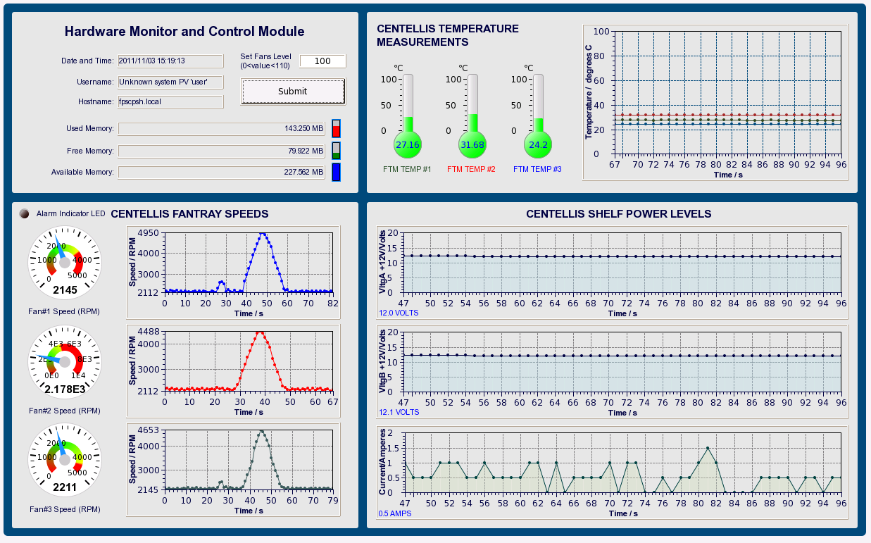
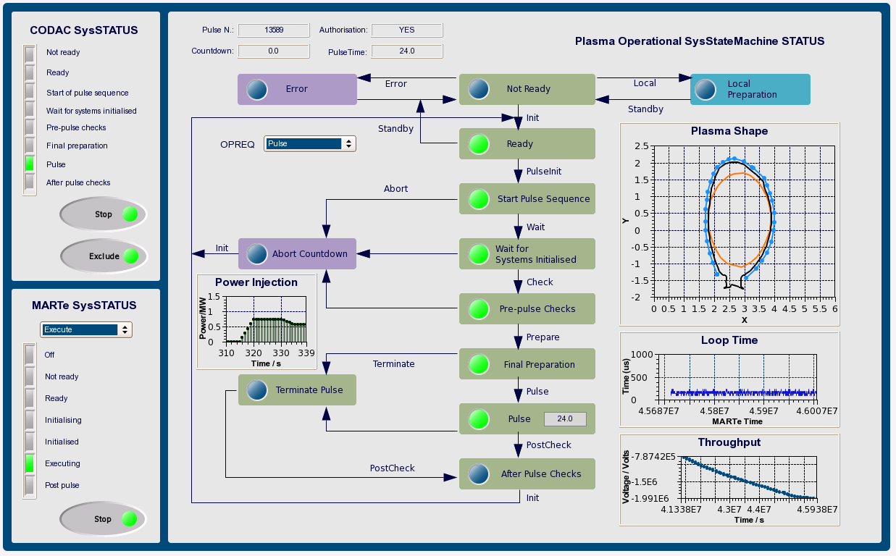
ITER
ITER-FPSC-vBetaVersionPanelsOPI-UserManual.doc, Nadine Utzel, 2011

Slide 6
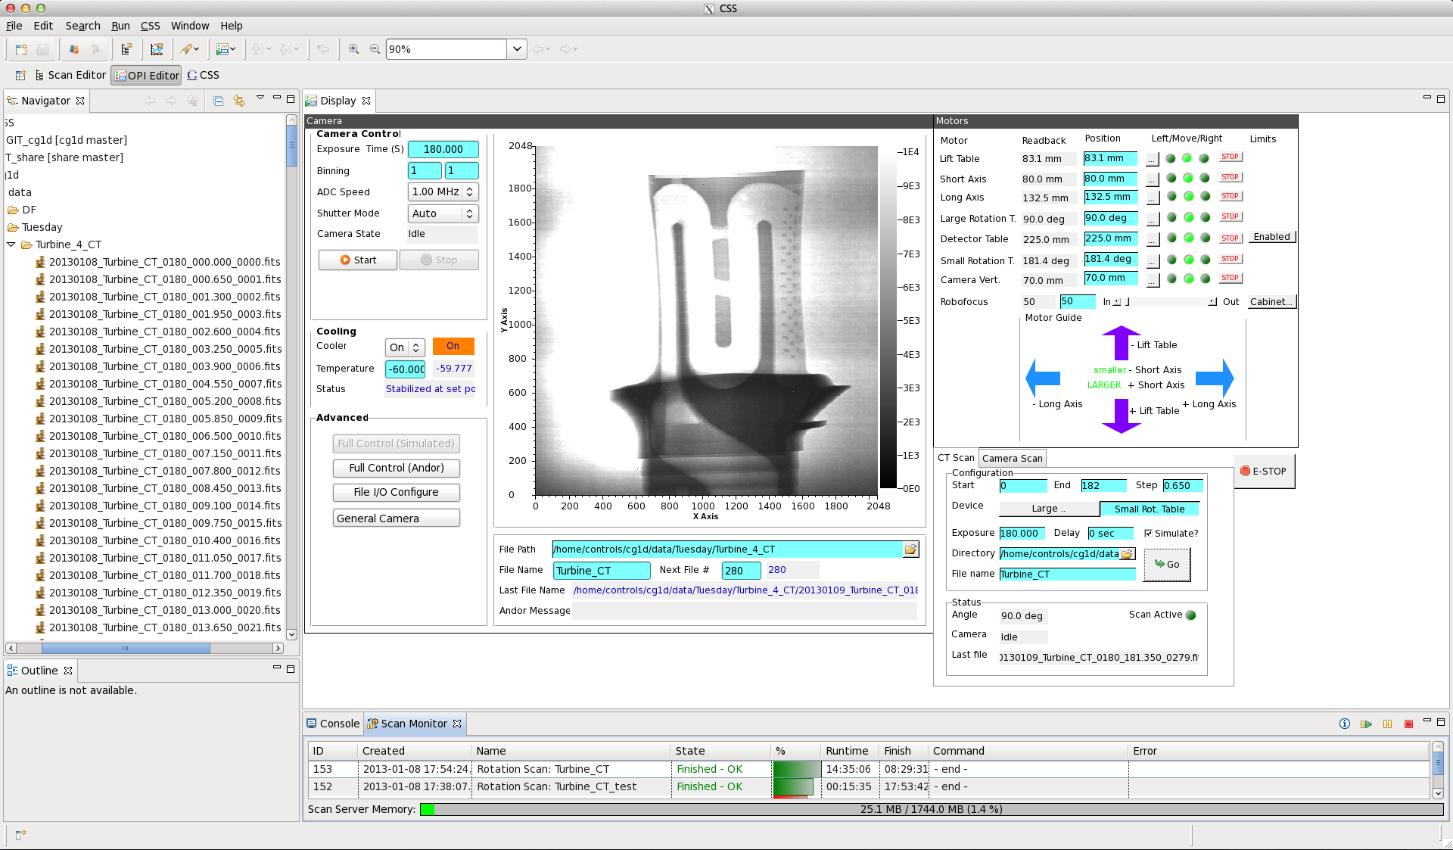
ORNL ‘CG-1D’ Beam Line
Neutron Tomography, EPICS/CSS since Jan. 2013

Slide 7
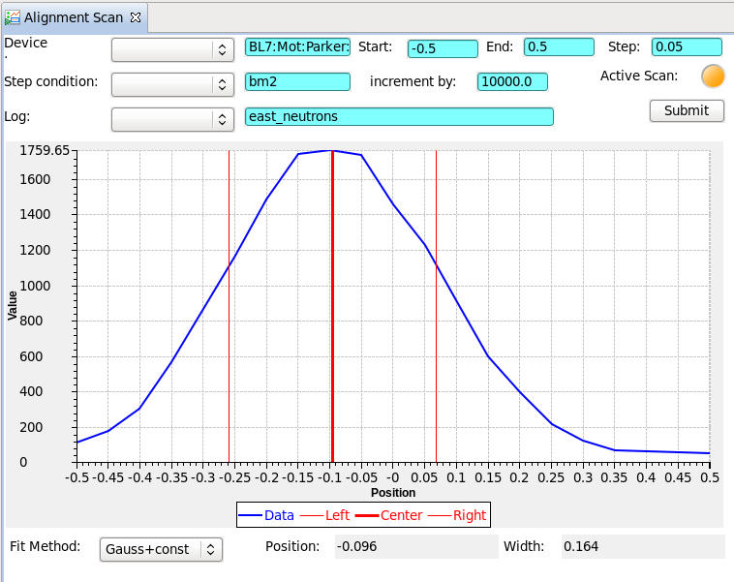
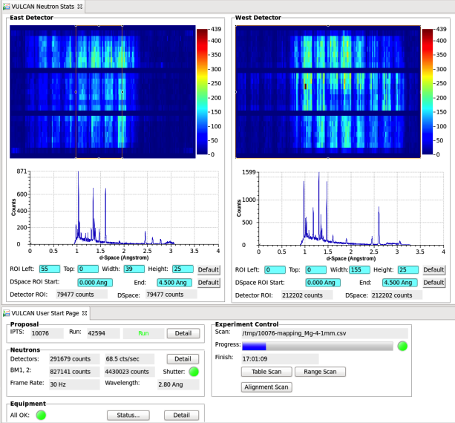
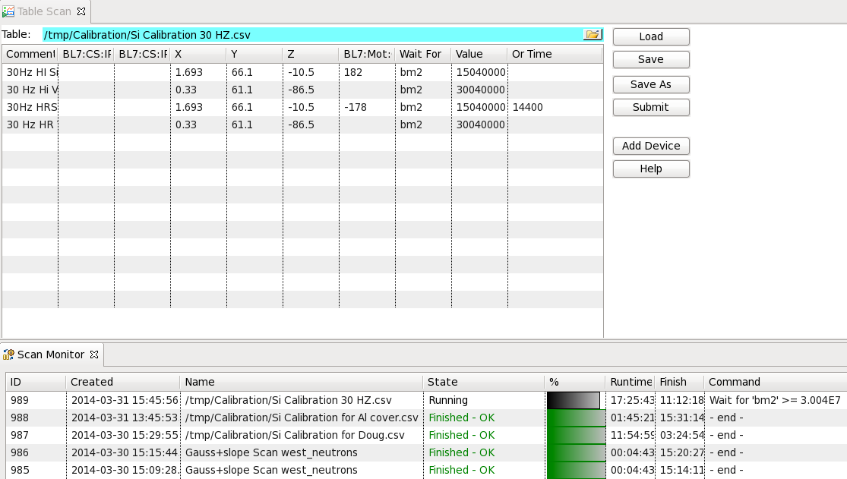
ORNL SNS ‘VULCAN’ Beam Line
Engineering Diffractometer, EPICS/CSS since March 2014

Slide 8
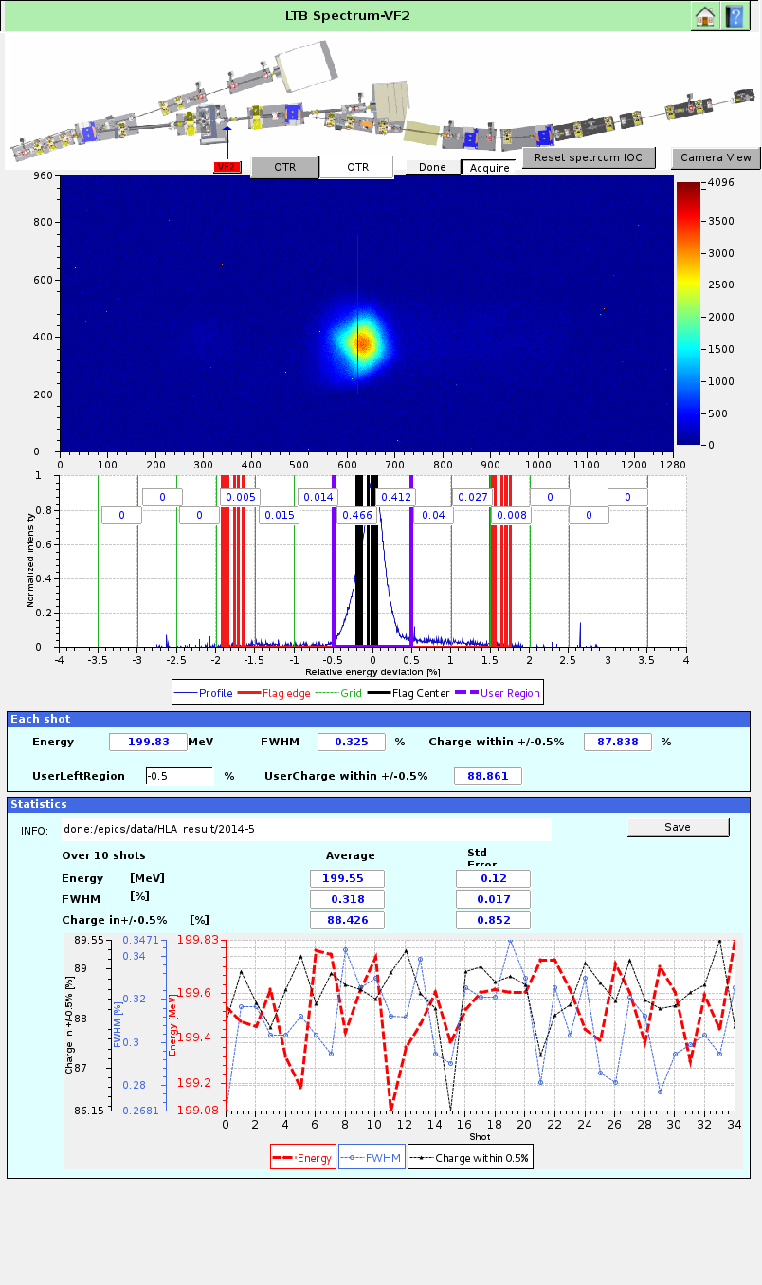
BNL NSLS2
Kunal Shroff, May 2014

Slide 9
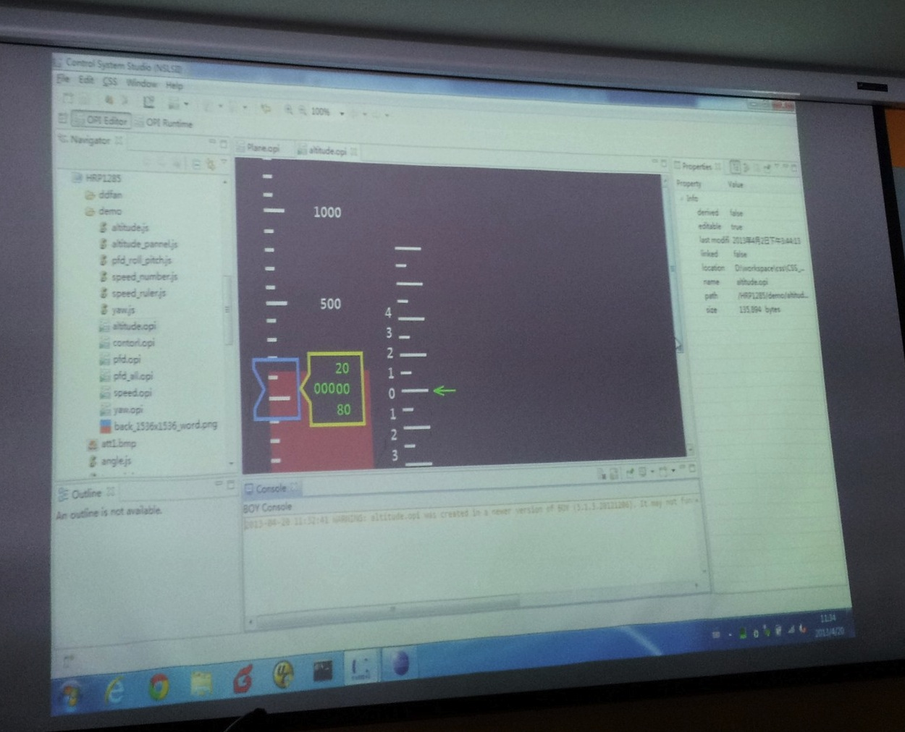
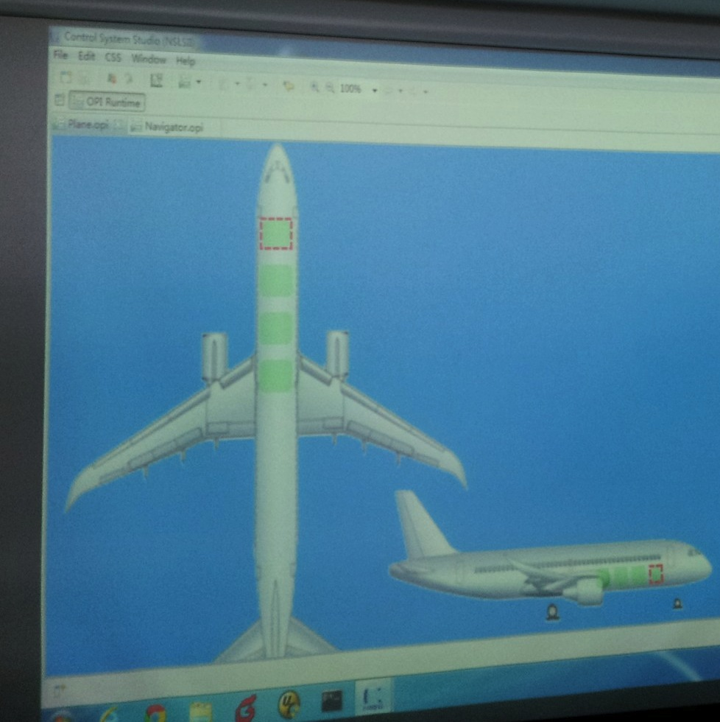
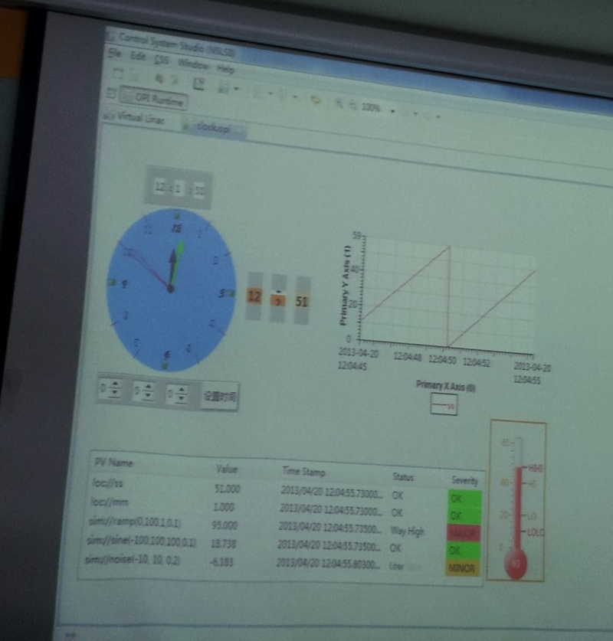
Airplane Simulator/Test
Somewhere …

Slide 10
What is CS-Studio?

Slide 11
CS-Studio Components
Common Use
Display Builder
Data Browser
Probe
PV Table
PV Tree
Channel Access
PV Autocomplete from History
Selected Use
Alarm System
Archive Appliance, RDB Archiver, Channel Archiver
ChannelFinder
Olog, SNS Elog
PV Access, MQTT
Autocomplete from Channel Finder, SNS PV database, Archive

Slide 12
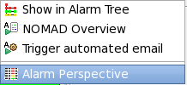
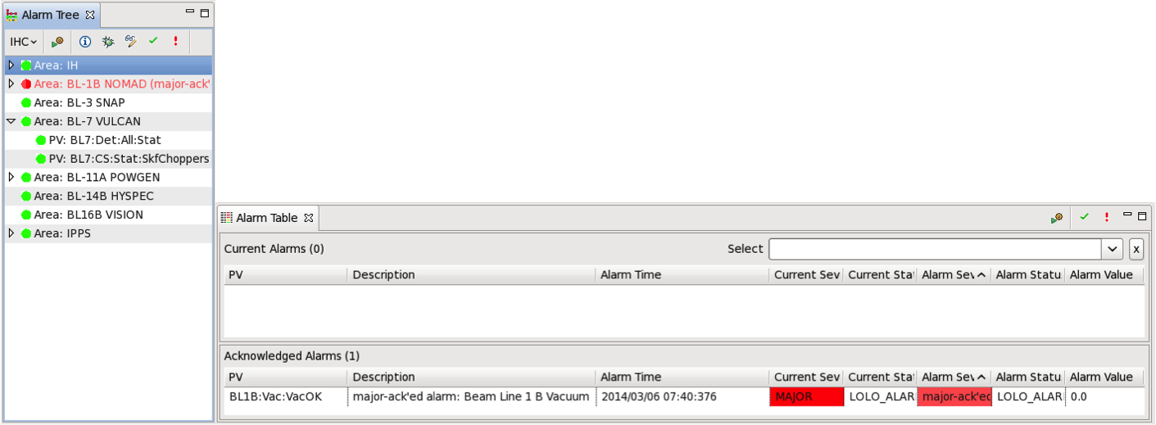
Integration: Alarm…
Context-Menu
Complete Alarm Perspective: Tree view, Table of current alarms

Slide 13
Integration: Alarm…

Slide 14
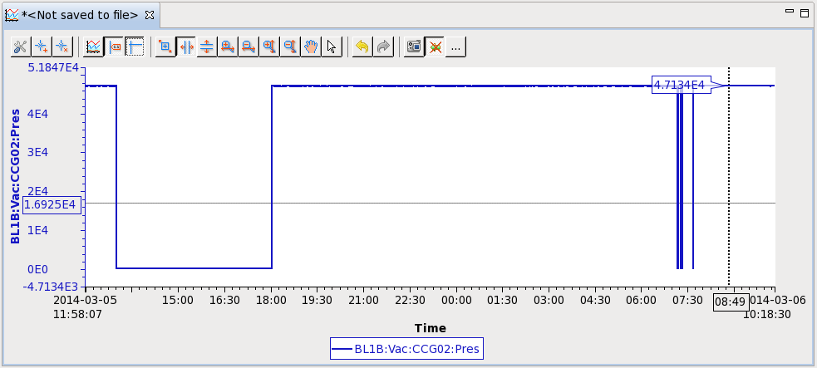
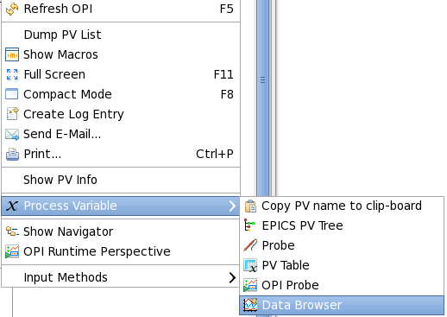
Integration: Alarm…

Slide 15
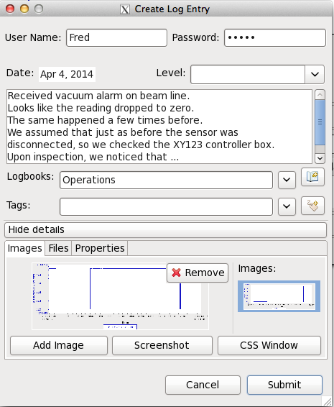
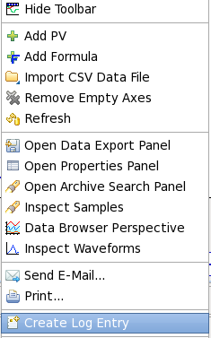
Integration: Alarm…

Slide 16
CS-Studio
is a collection of components. Integrated Workflow:
Alarm display
Display Builder (Channel Access)
Data Browser (with RDB Archive)
Logbook (SNS Elog)
Result:

Slide 17
Evolution of CS-Studio
JavaFX
SWT
BOY
Display Builder
Display Builder
Data Browser
Data Browser
Data Browser
PV Tree
PV Tree
PV Tree
Probe
Probe
Probe
PV Table
PV Table
PV Table
Alarms
Alarms
Alarms
Channels
Channels
Channels
Scan
Scan
Scan
… more …
… more …
… more …
Eclipse
Eclipse
Phoebus
Java 8
Java 8
Java 9, 10
Since ~2010: Operational at several sites
Since ~2016: SNS beam lines, planned for ESS
2019: SNS beam lines

Slide 18
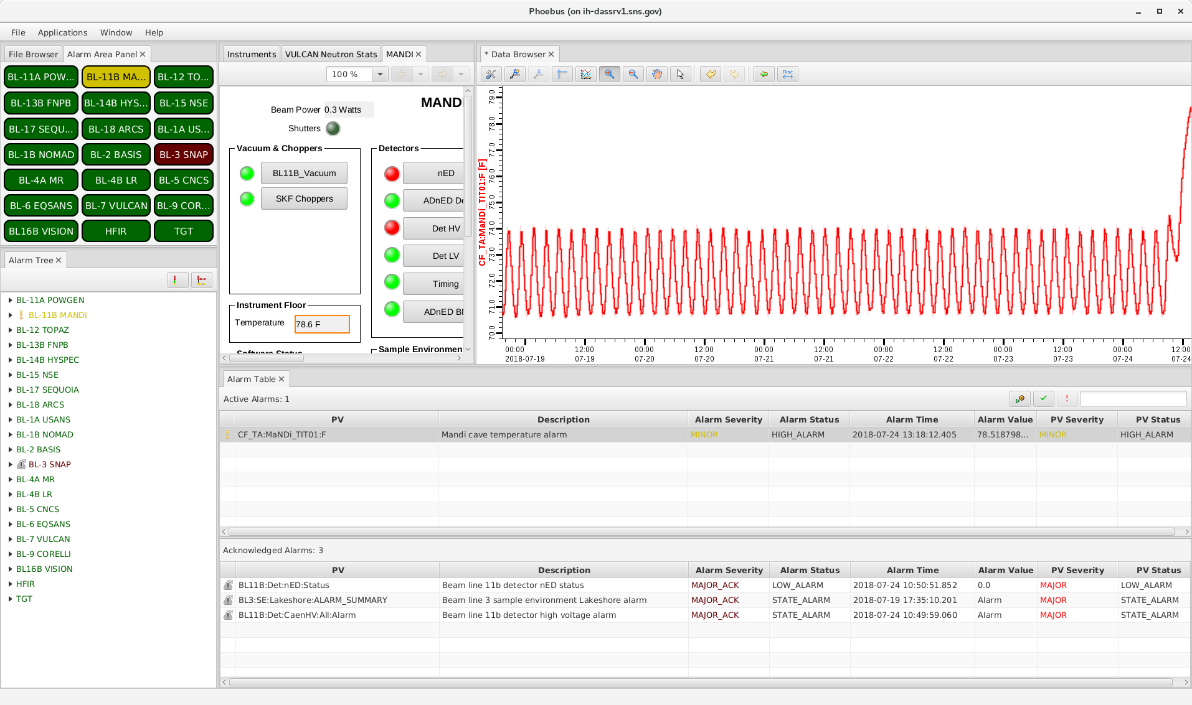
From 2014 to 2018

Slide 19
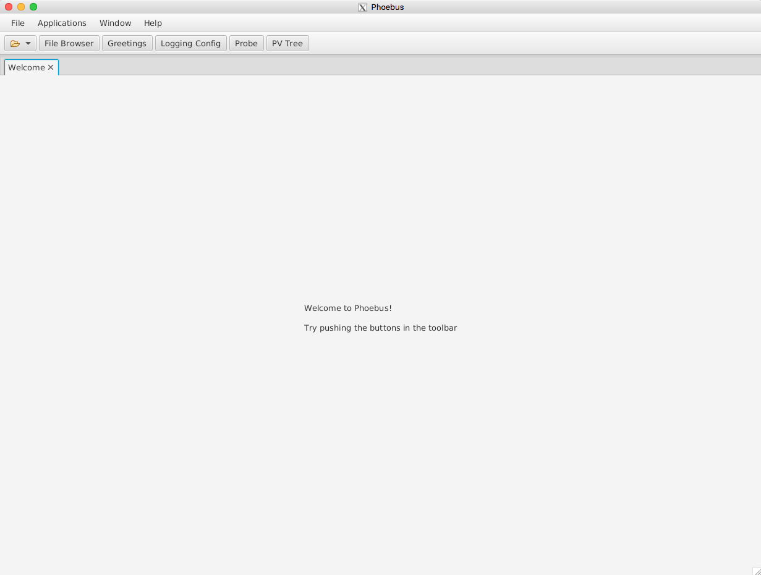
Getting Started with CSS
Start `css`

Slide 20
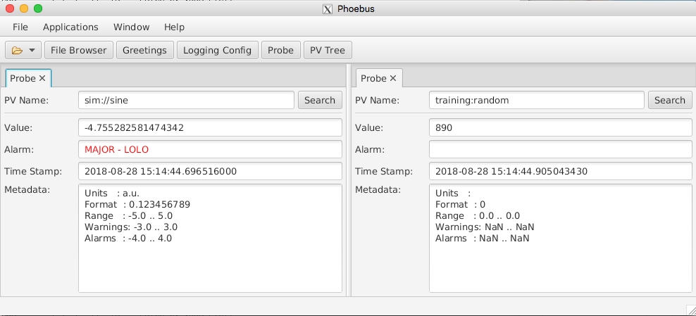
Exercise: Probe
Use “Probe” in toolbar or Menu Applications, Display, Probe
Enter PV name “sim://sine”
Open another Probe for “training:random” (or some other PV from your IOC)
Close Probe
Open it again
Note previously used PVs in history as you enter new PV
Right-click on the “Probe” tab, Select “Split Horizontally”, and move one of the probes to new panel.

Slide 21
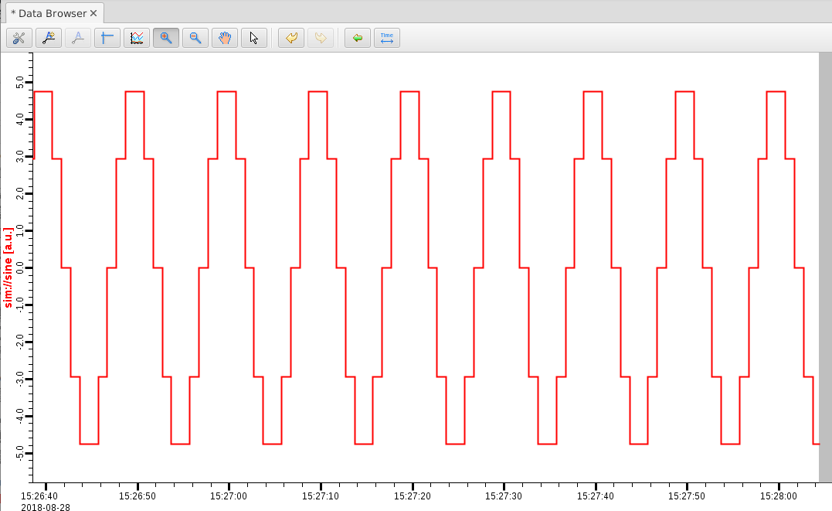
Exercise: Data Browser
Menu Applications, Display, Data Browser
Right-click on plot, Add PV, “sim://sine”
Wait a little, press Stagger button, then zoom and select a region on the time axis

Slide 22
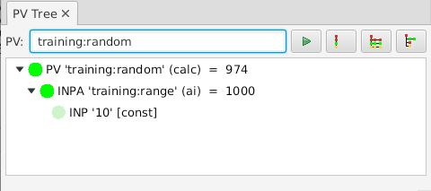
Exercise: PV Tree
Menu Applications, Display, PV Tree
Enter a PV from an IOC, like “training:random”

Slide 23
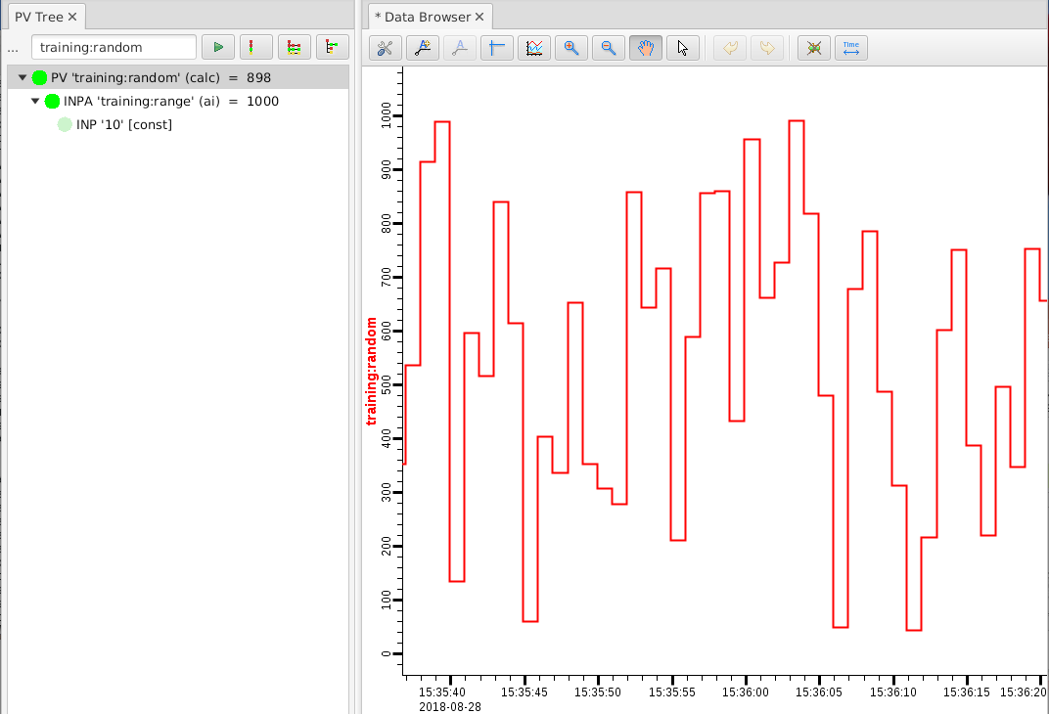
CSS PV Exchange
PV in any CSS Tool ➔ Context Menu ➔ Select other PV Tool
Try:
Right-click on item in PV Tree, select Data Browser

Slide 24
More Display Arrangements
Tab Context Menu:
Split Horizontally/Vertically
Detach
Lock Pane
Window Menu:
Show/Hide Toolbar
Always show tabs?
Save Layout As .. / Load Layout

Slide 25
Saved Layout Example
Hide the toolbar
Open File Browser
Split Pane Horizontally, leave file browser at left
Lock the left pane
Window, Save Layout As.., “Demo 1”
Create another one as “Demo 1”
Switch between them

Slide 26
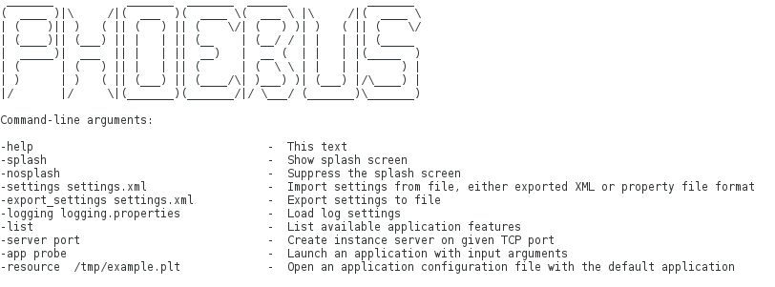
Settings
CSS saves its settings in ~/.phoebus
Change that via –Dphoebus.user=/path/to/other/dir on startup
Your ‘start’ script could copy certain saved layouts into that dir to share a set of layouts
For command line settings, run with -help:
For details on the ”-settings” file, see online help

